Slide 1
PRIVACYLENS · LOCAL PRIVACY FIREWALL
PRIVACYLENS:
AI AGENTS WITHOUT
THE PRIVACY TRADEOFF
A local privacy firewall that lets browser agents understand interfaces and act without exposing sensitive user information.

Slide 2
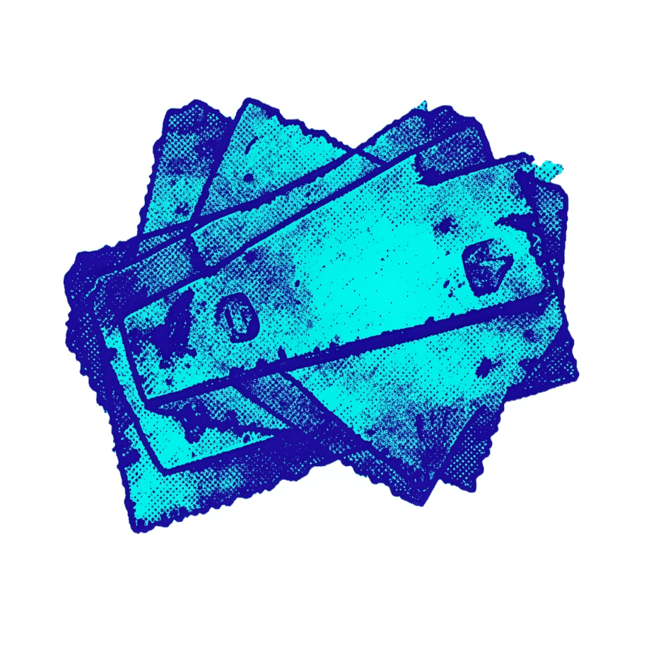
THE DEFAULT
1
Webpages and screenshots can expose Aadhaar, PAN, passwords, OTPs, cards, API keys, medical records, and personal messages.
AI AGENTS SEE TOO MUCH BY DEFAULT
3
Core principle
Compute what is sensitive locally; reason globally only on sanitized data.
2
The challenge: preserve enough interface meaning for automation while keeping raw secrets outside external AI models.

Slide 3

THE LOCAL BOUNDARY
PRIVACYLENS PUTS A LOCAL BOUNDARY AROUND THE AGENT
Capture
Gather raw inputs from sources
Detect
Identify sensitive elements
Local Privacy Boundary
Only sanitized context reaches the agent
Sanitize
Remove or obfuscate secrets
Validate
Ensure policy compliance
Fail closed when detection, sanitization, or validation fails.
Notes:
Read the diagram from the outside in: capture, detect, sanitize, validate. Only what survives all four reaches the agent, and any failure closes the boundary.

Slide 4





DETECTION COMBINES PATTERN, STRUCTURE, AND CONTEXT
Pattern detection
Indian identifiers plus email, phone, cards, bank details, OTPs, passwords, API keys, and IP addresses.
Structural analysis
Defense in depth
LOCAL INSPECTION
DOM elements, accessibility trees, metadata, and interface representations.
Multiple signals reduce missed detections and false positives.
Optional OCR and AI-based context
Screenshots, faces, and named entities when local dependencies are available.
Notes:
Detection runs locally and layers three kinds of signal: patterns, page structure, and optional OCR and AI context. Together they give defense in depth.

Slide 5






THE TRANSFORMATION
SANITIZATION PRESERVES MEANING, NOT SECRETS
The result is useful context without the original secret.
Replace sensitive text with typed placeholders such as [REDACTED:CARD] and [REDACTED:PASSWORD].
Raw Context
Typed Redaction
Meaning Preserved
README FILE
https://drive.google.com/file/d/1n2GtFY-Bp0blQ7-_Xi-zyueStrRHG8r5/view?usp=drive_link
Keep the interface structure and task context needed for reasoning.
Make original values non-recoverable from the external payload.
Show a privacy preview before any model-facing request.
Notes:
Walk the three bars on the left from raw context to typed redaction to preserved meaning, then step down the conveyor on the right: typed placeholders, kept structure, non-recoverable values, and a privacy preview before any model request.

Slide 6
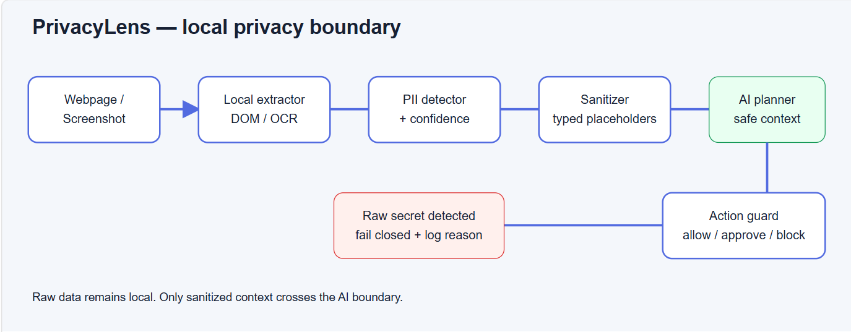
ONE-CLICK PROTECTION
THE BROWSER EXTENSION MAKES PROTECTION ONE CLICK
1
Run the local server, load the Manifest V3 extension, and pin PrivacyLens Local Guard.
2
On any webpage, choose Scan active page.
Review detected patterns, sanitized context, and the action-safety decision.
3
Page text stays on the local server at 127.0.0.1:8765; there is no cloud model dependency.
4
Notes:
Walk the tree left to right: set up, one click to scan, then two branches: what the reviewer sees, and the guarantee that page text never leaves the local server.

Slide 7

ACTION SAFETY
ACTION SAFETY STOPS UNSAFE AUTOMATION AT THE EDGE
Allowlist | Allowlist valid actions and reject invalid targets or unsafe operations.
Block | Block prompt injection and secret-bearing values before execution.
Approve | Require human approval for payment and destructive actions.
Scan again | Scan outgoing payloads again; block any request that still contains raw sensitive data.
Fail closed | Keep logs free of secrets and bind locally with fail-closed behavior.

Slide 8
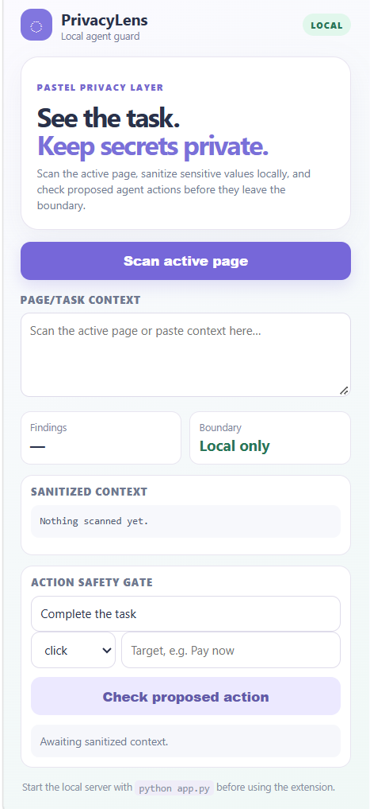

1
2
THE PROOF PLAN
FROM DEMO TO MEASURABLE PRIVACY PROOF
Demo
Test scenarios
Checkout card, email, OTP, and IP detection; typed redaction; safe validation; raw password blocked.
E-commerce, authentication, customer support, video conferencing, and developer settings.
3
4
Measure
Deliver
Detection recall, redaction precision, privacy leakage, context preservation, task success, latency, and security failures.
Working demo, extension, evaluation scripts, reproducible tests, setup instructions, and a 2–3 minute video.
Notes:
Walk the four stages in order: demo, test scenarios, measures, deliverables. The numbered chevrons read left to right, then down.

